Slide 1
Haplotype Phasing
Josh Cheung

Slide 2
Motivation
Humans have 2 copies of each chromosome
Genotyping technologies produce genotypes, mixing info from both chromosomes
We lose potentially valuable haplotype information
Determining the haplotypes of one individual given only his genotype is impossible

Slide 3




Example
An individual has the following haplotype:
Genotyping the individual results in:
If we are only given genotype, some possible haplotypes are:

Slide 4
Problem
Instead of examining the genotype of an individual, examine the genotypes of a population of individuals
Goal: given the genotypes of a population, find the fewest number of haplotypes that explain all of the genotypes
Benchmarks
Time complexity
Running time
Number of haplotypes produced
Accuracy (not necessarily the goal)

Slide 5
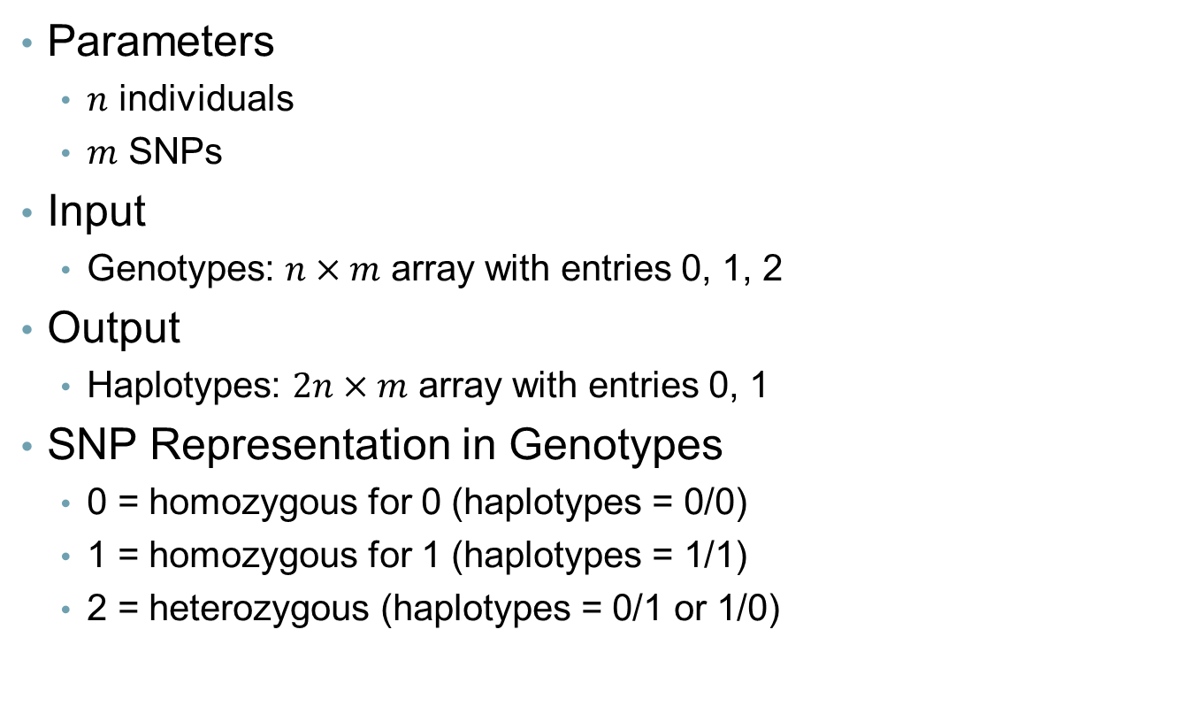
Overview
Parameters
$n$ individuals
$m$ SNPs
Input
Genotypes: $n×m$ array with entries 0, 1, 2
Output
Haplotypes: $2n×m$ array with entries 0, 1
SNP Representation in Genotypes
0 = homozygous for 0 (haplotypes = 0/0)
1 = homozygous for 1 (haplotypes = 1/1)
2 = heterozygous (haplotypes = 0/1 or 1/0)

Slide 6

Baselines
Trivial Solution
Let SNP_{ij} = SNP at position j of individual i
Each SNP_{ij} in the solution can be a 0, 1
Enumerate $2^{2mn}$ possible solutions and select the valid solution that uses the minimum number of haplotypes
Greedy Algorithm

Slide 7
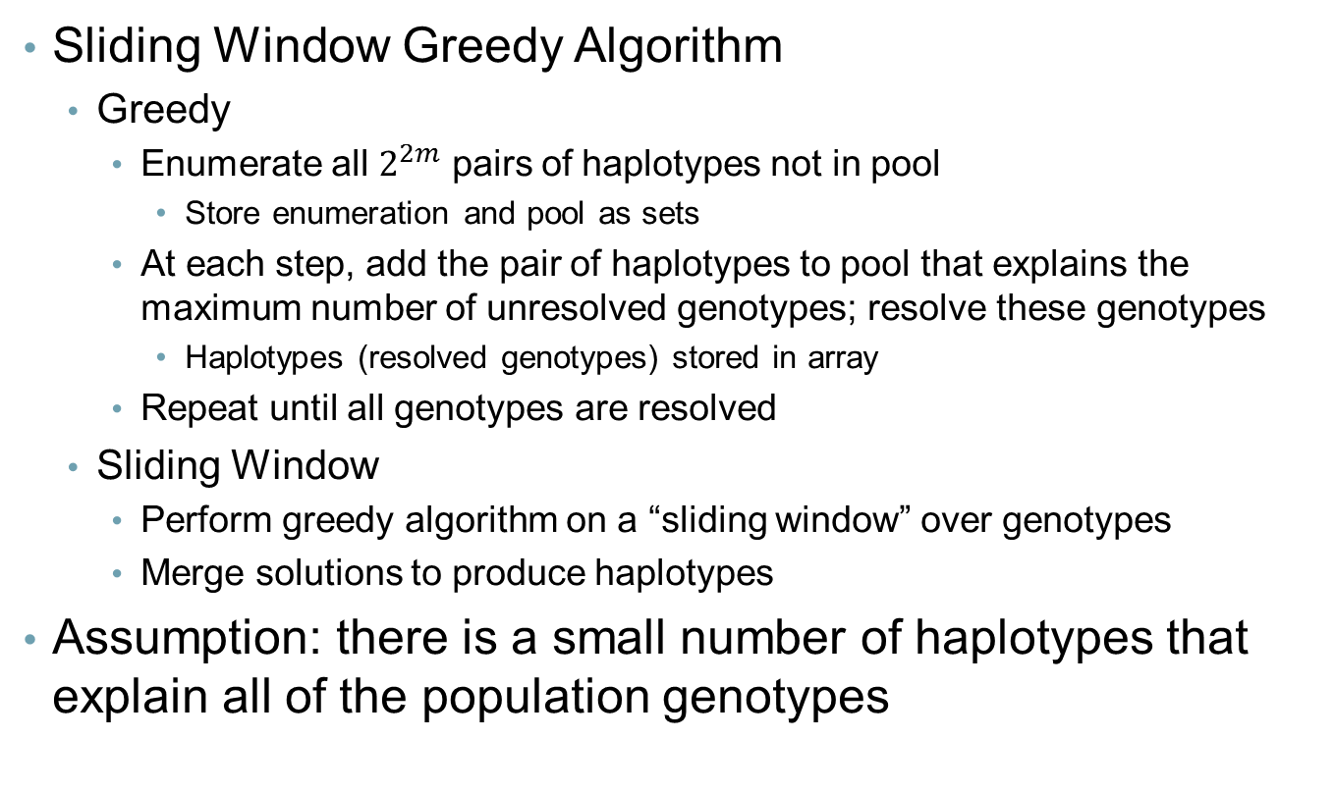
Proposed Solution
Sliding Window Greedy Algorithm
Greedy
Enumerate all $2^{2m}$ pairs of haplotypes not in pool
Store enumeration and pool as sets
At each step, add the pair of haplotypes to pool that explains the maximum number of unresolved genotypes; resolve these genotypes
Haplotypes (resolved genotypes) stored in array
Repeat until all genotypes are resolved
Sliding Window
Perform greedy algorithm on a “sliding window” over genotypes
Merge solutions to produce haplotypes
Assumption: there is a small number of haplotypes that explain all of the population genotypes

Slide 8
Sliding Window Greedy
Genotypes
Phased Partition 1
1 | 0 | 0 | 0 | 0
1 | 0 | 0 | 1 | 0
1 | 0 | 0 | 0 | 0
1 | 0 | 0 | 1 | 1
1 | 0 | 0 | 0 | 0
1 | 0 | 0 | 0 | 1
1 | 0 | 0 | 0 | 1
1 | 0 | 0 | 0 | 1
1 | 0 | 0 | 0 | 0
1 | 0 | 0 | 0 | 1
1 | 0 | 0 | 0 | 1
1 | 0 | 0 | 0 | 1
1 | 0 | 0 | 0 | 1
1 | 0 | 1 | 1 | 1
1 | 0 | 0 | 0 | 0
1 | 0 | 1 | 1 | 1
1 | 0 | 0 | 0 | 0
1 | 0 | 0 | 1 | 0
1 | 0 | 0 | 0 | 0
1 | 0 | 0 | 1 | 0
1 | 0 | 0 | 2 | 0 | 0 | 1 | 0 | 2 | 2
1 | 0 | 0 | 2 | 2 | 0 | 2 | 0 | 0 | 2
1 | 0 | 0 | 0 | 2 | 0 | 2 | 0 | 2 | 0
1 | 0 | 0 | 0 | 1 | 0 | 0 | 0 | 0 | 0
1 | 0 | 0 | 0 | 2 | 0 | 2 | 0 | 2 | 0
1 | 0 | 0 | 0 | 1 | 0 | 0 | 0 | 0 | 0
1 | 0 | 2 | 2 | 1 | 2 | 0 | 2 | 0 | 2
1 | 0 | 2 | 2 | 2 | 2 | 2 | 2 | 2 | 2
1 | 0 | 0 | 2 | 0 | 2 | 2 | 2 | 2 | 2
1 | 0 | 0 | 2 | 0 | 2 | 2 | 2 | 2 | 2

Slide 9
Sliding Window Greedy
Genotypes
Phased Partition 2
0 | 0 | 0 | 1 | 0
1 | 0 | 0 | 1 | 0
0 | 1 | 0 | 0 | 0
1 | 0 | 0 | 1 | 0
0 | 1 | 0 | 0 | 0
0 | 0 | 0 | 1 | 0
0 | 1 | 0 | 0 | 0
0 | 1 | 0 | 0 | 0
0 | 1 | 0 | 0 | 0
0 | 0 | 0 | 1 | 0
0 | 1 | 0 | 0 | 0
0 | 1 | 0 | 0 | 0
0 | 1 | 0 | 0 | 0
1 | 1 | 1 | 0 | 1
0 | 1 | 0 | 0 | 0
1 | 0 | 1 | 1 | 1
0 | 0 | 0 | 1 | 0
1 | 0 | 1 | 0 | 1
0 | 0 | 0 | 1 | 0
1 | 0 | 1 | 0 | 1
1 | 0 | 0 | 2 | 0 | 0 | 1 | 0 | 2 | 2
1 | 0 | 0 | 2 | 2 | 0 | 2 | 0 | 0 | 2
1 | 0 | 0 | 0 | 2 | 0 | 2 | 0 | 2 | 0
1 | 0 | 0 | 0 | 1 | 0 | 0 | 0 | 0 | 0
1 | 0 | 0 | 0 | 2 | 0 | 2 | 0 | 2 | 0
1 | 0 | 0 | 0 | 1 | 0 | 0 | 0 | 0 | 0
1 | 0 | 2 | 2 | 1 | 2 | 0 | 2 | 0 | 2
1 | 0 | 2 | 2 | 2 | 2 | 2 | 2 | 2 | 2
1 | 0 | 0 | 2 | 0 | 2 | 2 | 2 | 2 | 2
1 | 0 | 0 | 2 | 0 | 2 | 2 | 2 | 2 | 2

Slide 10
Sliding Window Greedy
Genotypes
Phased Partition 3
1 | 0 | 1 | 0
1 | 0 | 0 | 1
0 | 0 | 0 | 0
1 | 0 | 0 | 1
1 | 0 | 1 | 0
0 | 0 | 0 | 0
0 | 0 | 0 | 0
0 | 0 | 0 | 0
1 | 0 | 1 | 0
0 | 0 | 0 | 0
0 | 0 | 0 | 0
0 | 0 | 0 | 0
0 | 0 | 0 | 0
0 | 1 | 0 | 1
1 | 0 | 1 | 0
0 | 1 | 0 | 1
1 | 0 | 1 | 0
0 | 1 | 0 | 1
1 | 0 | 1 | 0
0 | 1 | 0 | 1
1 | 0 | 0 | 2 | 0 | 0 | 1 | 0 | 2 | 2
1 | 0 | 0 | 2 | 2 | 0 | 2 | 0 | 0 | 2
1 | 0 | 0 | 0 | 2 | 0 | 2 | 0 | 2 | 0
1 | 0 | 0 | 0 | 1 | 0 | 0 | 0 | 0 | 0
1 | 0 | 0 | 0 | 2 | 0 | 2 | 0 | 2 | 0
1 | 0 | 0 | 0 | 1 | 0 | 0 | 0 | 0 | 0
1 | 0 | 2 | 2 | 1 | 2 | 0 | 2 | 0 | 2
1 | 0 | 2 | 2 | 2 | 2 | 2 | 2 | 2 | 2
1 | 0 | 0 | 2 | 0 | 2 | 2 | 2 | 2 | 2
1 | 0 | 0 | 2 | 0 | 2 | 2 | 2 | 2 | 2

Slide 11
Sliding Window Greedy
Partition 1 + Partition 2
Merge 1
1 | 0 | 0 | 0 | 0 |  | 0 | 0 | 0 | 1 | 0
1 | 0 | 0 | 1 | 0 |  | 1 | 0 | 0 | 1 | 0
1 | 0 | 0 | 0 | 0 |  | 0 | 1 | 0 | 0 | 0
1 | 0 | 0 | 1 | 1 |  | 1 | 0 | 0 | 1 | 0
1 | 0 | 0 | 0 | 0 |  | 0 | 1 | 0 | 0 | 0
1 | 0 | 0 | 0 | 1 |  | 0 | 0 | 0 | 1 | 0
1 | 0 | 0 | 0 | 1 |  | 0 | 1 | 0 | 0 | 0
1 | 0 | 0 | 0 | 1 |  | 0 | 1 | 0 | 0 | 0
1 | 0 | 0 | 0 | 0 |  | 0 | 1 | 0 | 0 | 0
1 | 0 | 0 | 0 | 1 |  | 0 | 0 | 0 | 1 | 0
1 | 0 | 0 | 0 | 1 |  | 0 | 1 | 0 | 0 | 0
1 | 0 | 0 | 0 | 1 |  | 0 | 1 | 0 | 0 | 0
1 | 0 | 0 | 0 | 1 |  | 0 | 1 | 0 | 0 | 0
1 | 0 | 1 | 1 | 1 |  | 1 | 1 | 1 | 0 | 1
1 | 0 | 0 | 0 | 0 |  | 0 | 1 | 0 | 0 | 0
1 | 0 | 1 | 1 | 1 |  | 1 | 0 | 1 | 1 | 1
1 | 0 | 0 | 0 | 0 |  | 0 | 0 | 0 | 1 | 0
1 | 0 | 0 | 1 | 0 |  | 1 | 0 | 1 | 0 | 1
1 | 0 | 0 | 0 | 0 |  | 0 | 0 | 0 | 1 | 0
1 | 0 | 0 | 1 | 0 |  | 1 | 0 | 1 | 0 | 1
1 | 0 | 0 | 0 | 0 | 0 | 1 | 0
1 | 0 | 0 | 1 | 0 | 0 | 1 | 0
1 | 0 | 0 | 0 | 0 | 0 | 1 | 0
1 | 0 | 0 | 1 | 1 | 0 | 0 | 0
1 | 0 | 0 | 0 | 0 | 0 | 1 | 0
1 | 0 | 0 | 0 | 1 | 0 | 0 | 0
1 | 0 | 0 | 0 | 1 | 0 | 0 | 0
1 | 0 | 0 | 0 | 1 | 0 | 0 | 0
1 | 0 | 0 | 0 | 0 | 0 | 1 | 0
1 | 0 | 0 | 0 | 1 | 0 | 0 | 0
1 | 0 | 0 | 0 | 1 | 0 | 0 | 0
1 | 0 | 0 | 0 | 1 | 0 | 0 | 0
1 | 0 | 0 | 0 | 1 | 0 | 0 | 0
1 | 0 | 1 | 1 | 1 | 1 | 0 | 1
1 | 0 | 0 | 0 | 0 | 1 | 1 | 1
1 | 0 | 1 | 1 | 1 | 0 | 0 | 0
1 | 0 | 0 | 0 | 0 | 0 | 1 | 0
1 | 0 | 0 | 1 | 0 | 1 | 0 | 1
1 | 0 | 0 | 0 | 0 | 0 | 1 | 0
1 | 0 | 0 | 1 | 0 | 1 | 0 | 1

Slide 12
Sliding Window Greedy
Merge 1 + Partition 3
Merge 2 - Solution
1 | 0 | 0 | 0 | 0 | 0 | 1 | 0 |  | 1 | 0 | 1 | 0
1 | 0 | 0 | 1 | 0 | 0 | 1 | 0 |  | 1 | 0 | 0 | 1
1 | 0 | 0 | 0 | 0 | 0 | 1 | 0 |  | 0 | 0 | 0 | 0
1 | 0 | 0 | 1 | 1 | 0 | 0 | 0 |  | 1 | 0 | 0 | 1
1 | 0 | 0 | 0 | 0 | 0 | 1 | 0 |  | 1 | 0 | 1 | 0
1 | 0 | 0 | 0 | 1 | 0 | 0 | 0 |  | 0 | 0 | 0 | 0
1 | 0 | 0 | 0 | 1 | 0 | 0 | 0 |  | 0 | 0 | 0 | 0
1 | 0 | 0 | 0 | 1 | 0 | 0 | 0 |  | 0 | 0 | 0 | 0
1 | 0 | 0 | 0 | 0 | 0 | 1 | 0 |  | 1 | 0 | 1 | 0
1 | 0 | 0 | 0 | 1 | 0 | 0 | 0 |  | 0 | 0 | 0 | 0
1 | 0 | 0 | 0 | 1 | 0 | 0 | 0 |  | 0 | 0 | 0 | 0
1 | 0 | 0 | 0 | 1 | 0 | 0 | 0 |  | 0 | 0 | 0 | 0
1 | 0 | 0 | 0 | 1 | 0 | 0 | 0 |  | 0 | 0 | 0 | 0
1 | 0 | 1 | 1 | 1 | 1 | 0 | 1 |  | 0 | 1 | 0 | 1
1 | 0 | 0 | 0 | 0 | 1 | 1 | 1 |  | 1 | 0 | 1 | 0
1 | 0 | 1 | 1 | 1 | 0 | 0 | 0 |  | 0 | 1 | 0 | 1
1 | 0 | 0 | 0 | 0 | 0 | 1 | 0 |  | 1 | 0 | 1 | 0
1 | 0 | 0 | 1 | 0 | 1 | 0 | 1 |  | 0 | 1 | 0 | 1
1 | 0 | 0 | 0 | 0 | 0 | 1 | 0 |  | 1 | 0 | 1 | 0
1 | 0 | 0 | 1 | 0 | 1 | 0 | 1 |  | 0 | 1 | 0 | 1
1 | 0 | 0 | 0 | 0 | 0 | 1 | 0 | 1 | 0
1 | 0 | 0 | 1 | 0 | 0 | 1 | 0 | 0 | 1
1 | 0 | 0 | 0 | 0 | 0 | 1 | 0 | 0 | 1
1 | 0 | 0 | 1 | 1 | 0 | 0 | 0 | 0 | 0
1 | 0 | 0 | 0 | 0 | 0 | 1 | 0 | 1 | 0
1 | 0 | 0 | 0 | 1 | 0 | 0 | 0 | 0 | 0
1 | 0 | 0 | 0 | 1 | 0 | 0 | 0 | 0 | 0
1 | 0 | 0 | 0 | 1 | 0 | 0 | 0 | 0 | 0
1 | 0 | 0 | 0 | 0 | 0 | 1 | 0 | 1 | 0
1 | 0 | 0 | 0 | 1 | 0 | 0 | 0 | 0 | 0
1 | 0 | 0 | 0 | 1 | 0 | 0 | 0 | 0 | 0
1 | 0 | 0 | 0 | 1 | 0 | 0 | 0 | 0 | 0
1 | 0 | 0 | 0 | 1 | 0 | 0 | 0 | 0 | 0
1 | 0 | 1 | 1 | 1 | 1 | 0 | 1 | 0 | 1
1 | 0 | 0 | 0 | 0 | 1 | 1 | 1 | 0 | 1
1 | 0 | 1 | 1 | 1 | 0 | 0 | 0 | 1 | 0
1 | 0 | 0 | 0 | 0 | 0 | 1 | 0 | 1 | 0
1 | 0 | 0 | 1 | 0 | 1 | 0 | 1 | 0 | 1
1 | 0 | 0 | 0 | 0 | 0 | 1 | 0 | 1 | 0
1 | 0 | 0 | 1 | 0 | 1 | 0 | 1 | 0 | 1

Slide 13
Merging
If an individual is homozygous at all overlapping SNPs, it is impossible to determine which haplotypes should be aligned – arbitrary (25%)
If an individual is heterozygous at 2+ overlapping SNPs, it is possible that the haplotypes in each window are phased differently – arbitrary (25%)
If an individual is heterozygous at exactly 1 SNP, we can align the haplotypes correctly (50%)
0 | 1 | 1 | 0 | 0 |  | 0 | 0 | 0 | 1
1 | 1 | 0 | 0 | 0 |  | 0 | 0 | 1 | 0
0 | 1 | 1 | 0 | 0 | 0 | 1
1 | 1 | 0 | 0 | 0 | 1 | 0
or
0 | 1 | 1 | 0 | 0 | 1 | 0
1 | 1 | 0 | 0 | 0 | 0 | 1
0 | 1 | 1 | 1 | 0 |  | 1 | 1 | 0 | 1
1 | 1 | 0 | 0 | 1 |  | 0 | 0 | 1 | 0

Slide 14
Analyzing Performance
In simulations, a pool of 5 haplotypes is used
Each trial involves simulating a set of data, performing each algorithm on the same set of data and measuring benchmarks
Average benchmarks taken over 20 trials
In analyzing the sliding window greedy algorithm, a window length of 5 and increment of 3 (overlap of 2) is used
When examining the effect of number of SNPs, the number of individuals is held at 25
When examining the effect of number of individuals, the number of SNPs is held at 15

Slide 15
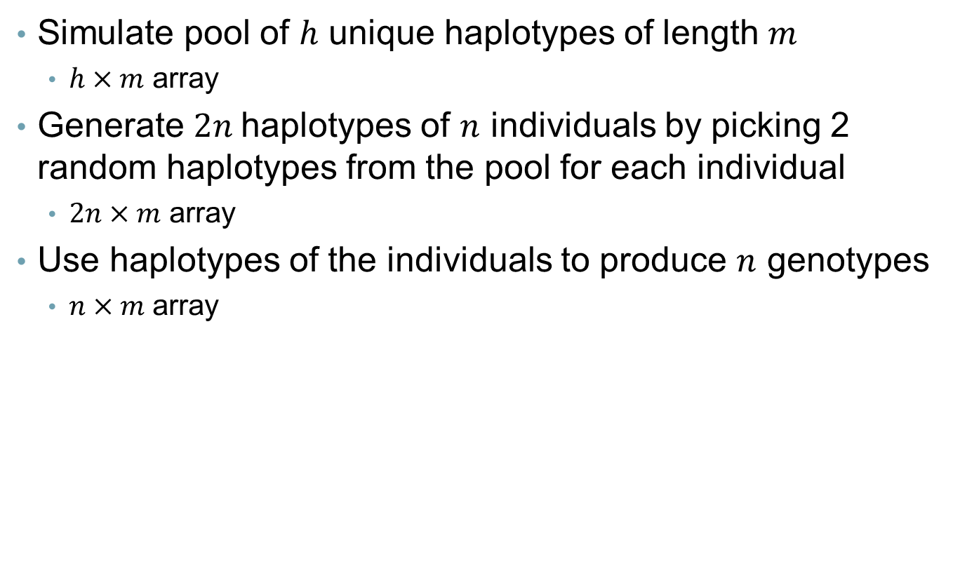
Simulations
Simulate pool of $h$ unique haplotypes of length $m$
$h×m$ array
Generate $2n$haplotypes of $n$ individuals by picking 2 random haplotypes from the pool for each individual
$2n×m$ array
Use haplotypes of the individuals to produce $n$ genotypes
$n×m$ array

Slide 16
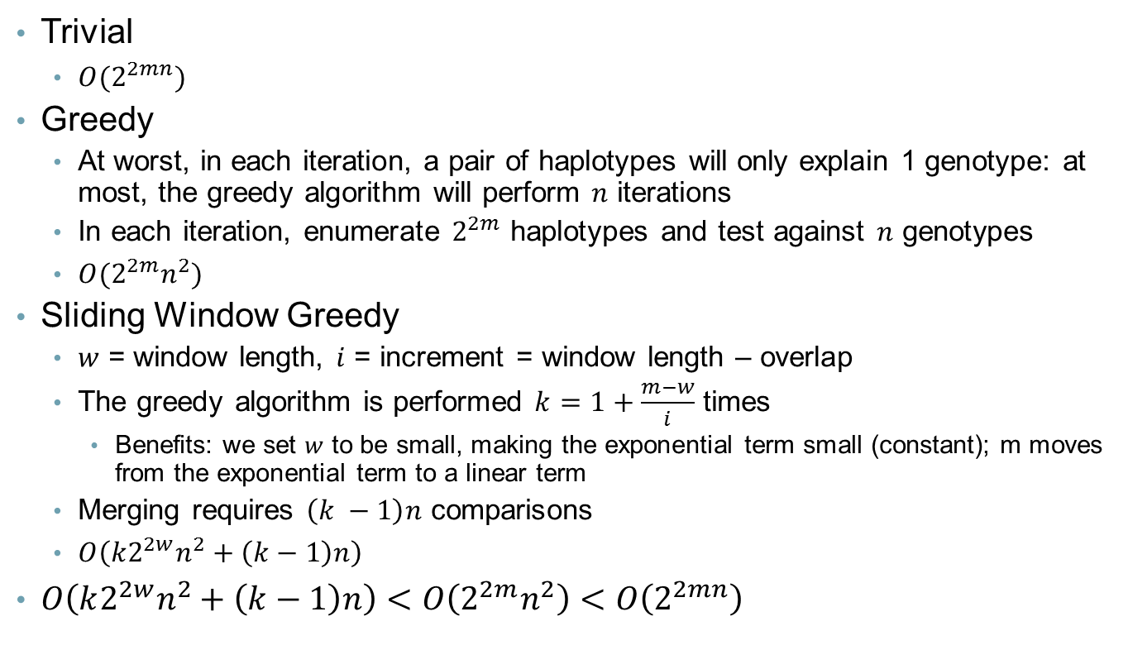
Time Complexity
Trivial
${O(2}^{2mn})$
Greedy
At worst, in each iteration, a pair of haplotypes will only explain 1 genotype: at most, the greedy algorithm will perform $n$ iterations
In each iteration, enumerate $2^{2m}$ haplotypes and test against $n$ genotypes
$O(2^{2m}n^{2})$
Sliding Window Greedy
$w$ = window length, $i$ = increment = window length – overlap
The greedy algorithm is performed $k=1+\frac{m−w}{i}$ times
Benefits: we set $w$ to be small, making the exponential term small (constant); m moves from the exponential term to a linear term
Merging requires $\left(k −1\right)n$ comparisons
$O\left(k2^{2w}n^{2}+\left(k−1\right)n\right)$
$O\left(k2^{2w}n^{2}+\left(k−1\right)n\right)<O\left(2^{2m}n^{2}\right)<O\left(2^{2mn}\right)$

Slide 17
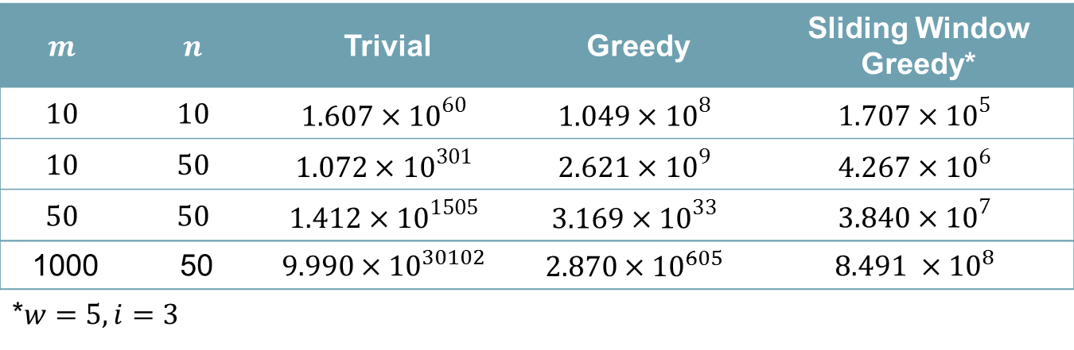
Time Complexity
$$m$$ | $$n$$ | Trivial | Greedy | Sliding Window Greedy*
$$10$$ | $$10$$ | $$1.607×{10}^{60}$$ | $$1.049×{10}^{8}$$ | $$1.707×{10}^{5}$$
$$10$$ | $$50$$ | $$1.072×{10}^{301}$$ | $$2.621×{10}^{9}$$ | $$4.267×{10}^{6}$$
$$50$$ | $$50$$ | $$1.412×{10}^{1505}$$ | $$3.169×{10}^{33}$$ | $$3.840×{10}^{7}$$
1000 | 50 | $$9.990×{10}^{30102}$$ | $$2.870×{10}^{605}$$ | $$8.491 ×{10}^{8}$$
*$w=5, i=3$

Slide 18
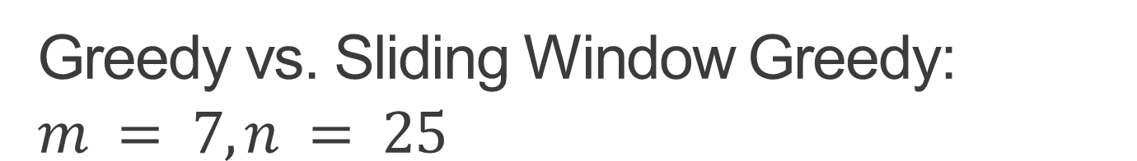
Greedy vs. Sliding Window Greedy: $$m = 7, n = 25$$
 | Time (s) | Number of Haplotypes | Accuracy
Greedy | 50.085 | 6.7 | 0.826
Sliding Window Greedy | 3.182 | 9.8 | 0.817

Slide 19
Running Time

Slide 20
Parsimony

Slide 21
Accuracy

Slide 22
Conclusions
Trivial and greedy algorithms are slow due to exponential term
Partitioning the genotypes and using the sliding window algorithm results in approximately polynomial complexity
Although sliding window greedy is much faster, greedy usually produces the more parsimonious answer
Sliding window greedy does not always produce the optimal solution: number of haplotypes found greater than the number of haplotypes used to simulate data
Merging is an issue

